Slide 1
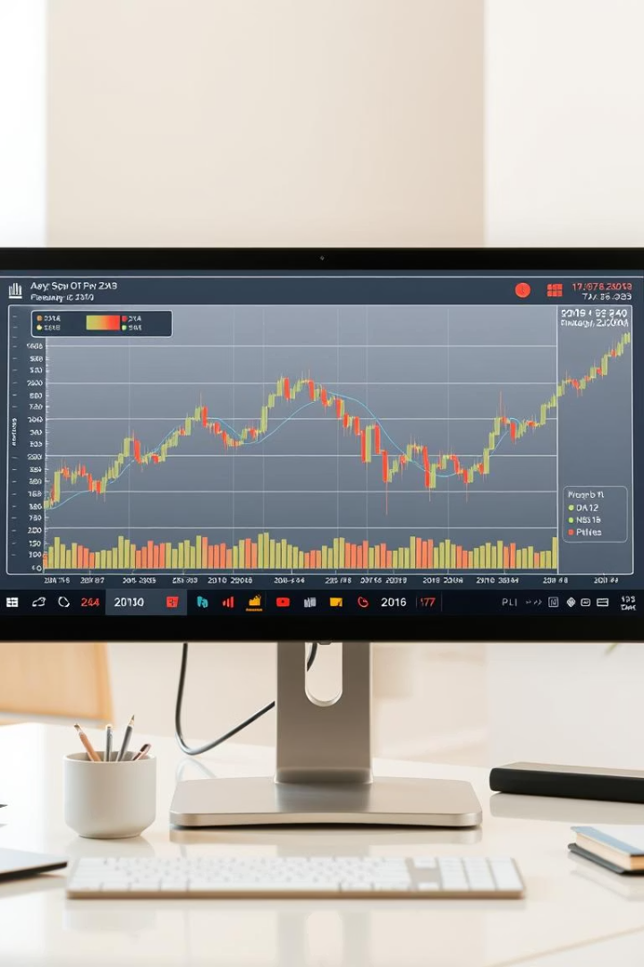
Risk and Return Analysis of a Stock Portfolio
We analyze the risk and return of a stock portfolio containing Apple, Microsoft, Google, and Amazon. This study uses Python with libraries yfinance, pandas_datareader, matplotlib, and seaborn for comprehensive financial insights.

Slide 2

Data Acquisition
Time Period
Data Sources
From January 1, 2020 to present for recent and relevant data.
Primary data via yfinance API; fallback using pandas_datareader from Stooq.
Adjustments
Prices auto-adjusted for dividends and stock splits ensuring accuracy.

Slide 3

Portfolio Setup
Equal Weights
Initial Investment
Each stock allocated 25% of the portfolio for balanced exposure.
Hypothetical capital of $10,000 is assumed for calculations.
Strategy
No rebalancing; buy and hold to capture long-term trends.

Slide 4
Return Calculation
Key Metrics
Portfolio Returns
Daily returns: percent change of adjusted closing prices
AAPL: 30%
Annualized returns: scaled by 252 trading days
MSFT: 25%
GOOGL: 20%
AMZN: 15%

Slide 5
Risk Calculation: Volatility
Understanding Volatility
Stock Volatilites (Annual)
Measures price fluctuations via standard deviation of daily returns.
AAPL: 25%
MSFT: 20%
Annualized volatility accounts for sqrt of trading days.
GOOGL: 18%
AMZN: 22%

Slide 6





Risk-Adjusted Return: Sharpe Ratio
Sharpe Ratio Formula
=(Portfolio Return - Risk-Free Rate) / Portfolio Volatility
Risk-Free Rate
10-Year Treasury bond yield used as benchmark interest rate.
Interpretation
Higher Sharpe ratios indicate better risk-adjusted performance.
Example
Return: 20%, Volatility: 20%, Risk-Free Rate: 4%

Slide 7
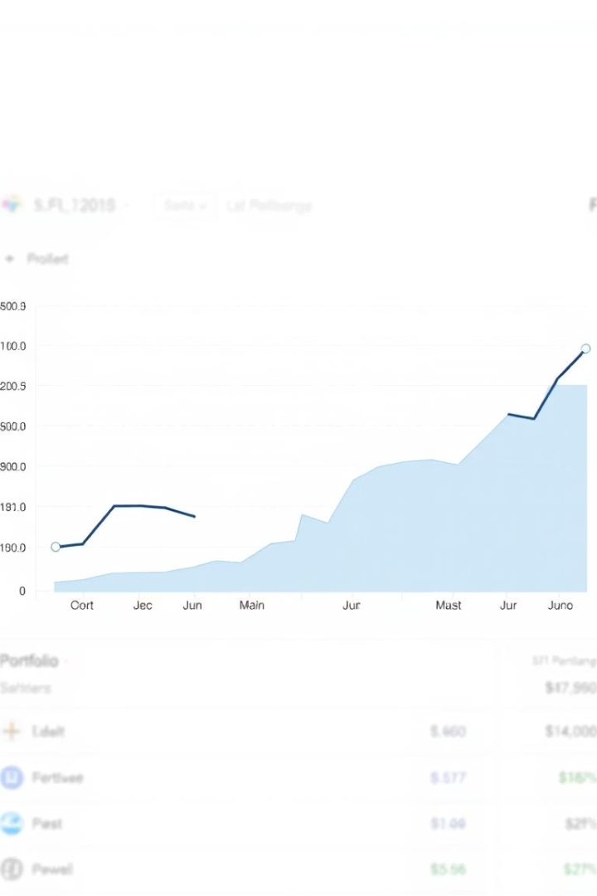
Visualization: Performance Over Time
Comparative View
Benchmarking
Portfolio cumulative returns tracked over time against stocks and S&P 500.
Highlights when portfolio outperforms or underperforms market.
Insights
Visual cues for identifying strong and weak periods.

Slide 8
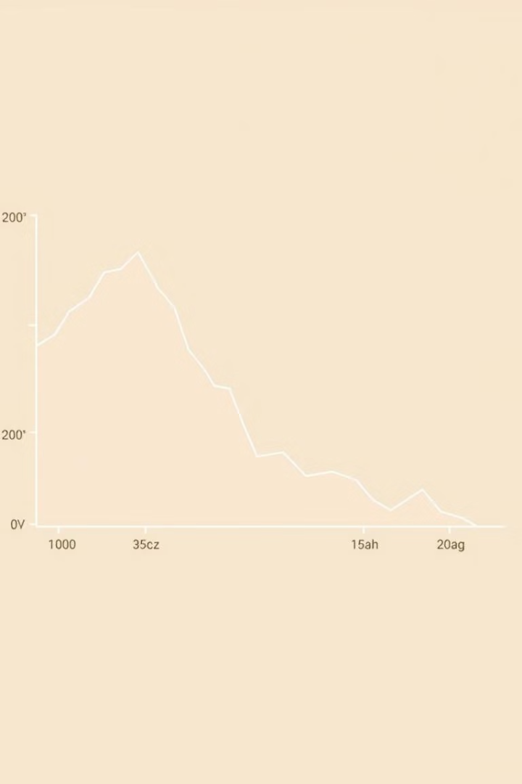
Drawdown Analysis
Max Drawdown Meaning
Calculation Steps
Identify highest peak
Measures largest peak-to-trough loss over a timeframe.
Locate lowest trough following peak
Calculate percentage decline
Importance
Assesses potential worst-case losses for investors.

Slide 9
Correlation Analysis
Correlation Matrix
Diversification Benefits
Represents relationships between pairs of stock returns.
Low or negative correlations reduce overall portfolio risk.
Values range from -1 to 1 indicating strength and direction.
Helps in building more resilient investment portfolios.

Slide 10

Conclusion and Summary
Key Findings
Comparison
Portfolio shows balanced returns with moderate volatility and solid Sharpe ratio.
Portfolio performance measured favorably against S&P 500 benchmark.
Next Steps
Consider strategy optimization for higher returns or lower risk.

